Slide 1
The Role of the Mother in the Feeding Skill Acquisition in Immature Sumatran Orangutans
Supervisor 1: TBD
Supervisor 2: Dr. Caroline Schuppli
Author: Mikeliban Mulati

Slide 2
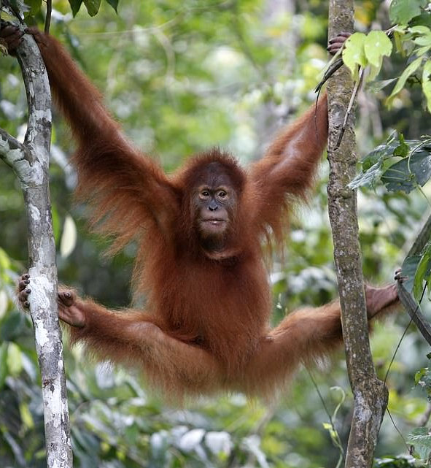
Content
Theoretical background
Research question
Predictors
Hypotheses
Methods
Analyses
https://www.dailymail.co.uk/news/article-7154111/Orangutan-released-wild-Sumatra.html

Slide 3
Theoretical Background
Feeding: processing, gathering, ingesting food items.
Food transfer (hand to hand [hth], month to mouth [mtm], mouth to hand [mth], & hand to mouth [htm])
Food sharing <- Food was virtually only shared if non-owners approached food owners and actively tried to acquire food by begging or by taking. (Jäggi, van Schaik, Fischer, & Burkart, 2010).
​"Mothers were usually passively tolerant, allowing offspring to take food but hardly ever regulated." (Jaeggi, Van Noordwijk, & Van Schaik, 2008, p. 533)
No teaching has been observed.
Parent-Offspring Conflict (POC) <- hypotheses

Slide 4
The role of mothers in other primates
Bee-fishing in chimps: “the proportion of time mothers spent at bee nest sites was high when they were accompanied by young daughters and decreased as daughters aged, while the opposite pattern was found for sons.” (Estienne, Robira, Mundry, Deschner, & Boesch, 2019)
Nut-cracking in chimps: “mothers were more likely to share nuts with their sons than with their daughters, and the more their offspring begged”; “male immatures were also found to beg more often than females” (Estienne, Cohen, Wittig, & Boesch, 2019).

Slide 5
The role of mothers in other primates
Ant-fishing in chimps: poorer the skill of the offspring, longer the mother spent ant-fishing with the offspring. mothers are highly tolerant to offspring, even when the behavior of the offspring may disrupt the termite-fishing attempt (Lonsdorf, 2006).
Food sharing in bonobos: grooming impacts sharing <- more tolerated transfers (Jäggi, van Schaik, Fischer, & Burkart, 2010).

Slide 6
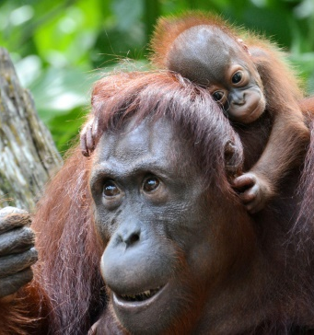

Research Question
What is the role of the mother in the feeding skill acquisition process in immature Sumatran orangutans?
https://phys.org/news/2016-07-group-bornean-orangutan-critically-endangered.html

Slide 7
Independent & dependent variable
Mother’s Tolerence (yes/no)
Offpspring‘s age
Offspring‘s feeding competence
Complexity of the food item
Rarity of the food item
Condition (zoo/wild)
Physical condition of the offspring

Slide 8
Hypotheses
Age ~ frequency of acceptance (mother’s tolerence)
“as the offspring increases in size, the relative energetic expense to it of competing with its parents should decline” (Trivers, 1974, p. 254). <- less parental investment
POC: more avoidance behavior and aggression show as the child grows (Trivers, 1974).
infants up to at least 4 years of age in this population foraged mostly together with the mother (mostly same food items) and only the weaned immature foraged more independently (Jaeggi, 2010).

Slide 9
Hypotheses
2. Food Competence of the child ~ frequency of acceptance (mother’s tolerence)
Feeding speed: “how much time it took an individual to process a food item from picking to ingestion.” (Schuppli et al., 2016, p. 4)
If the child is well competent in foraging <- the parental investment in foraging skill decreases (Trivers, 1974).

Slide 10
Hypotheses
3. Difficulty to approach the food ~ frequency of acceptance (mother’s tolerence)
Measurement: how many steps does it take until the infant gets the Fitem?
POC: mothers support their offspring by sharing high-quality and difficult food items, thus responding to their offspring’s solicitation (Trivers, 1974).

Slide 11
Hypotheses
4. Rarity of the food item ~ frequency of acceptance (mother’s tolerence)
Measurement: the proportion of the occurrence of the Fitem in all observed begging events.
“conflict frequencies increase with decreasing food availability” (Falkner, 2015, p. 77).

Slide 12
Hypotheses
5. Body condition of the child ~ frequency of acceptance (mother’s tolerence)
Measurement: body size (e.g. lower than the mean) <- measure the length of arm with laser; outstanding health issues.
“the weaker and more vulnerable the offspring is, the more effort is selected from the parent to take care of it.” (Trivers, 1974, p.257)

Slide 13
Hypotheses
6. The mean frequency of acceptance (mother’s tolerence) in the wild < in the zoo
More frequent food resource (10 am, 12pm…) in the zoo than in the wild
Smaller variety of the food item in the zoo than in the wild
Easier to acquire food in the zoo than in the wild

Slide 14

Methods
Data from the wild:
Existing detailed data set on begging behavior will be expanded:
Coding videos of begging events from the wild
Transfer data on begging events from paper data to the data set
Data quantity:
750 existing begging events,
Around 550 will be added during this project
Targeted total sample size: 1300 begging events
Longitudinal & cross-sectional data set
XX immatures
Aged 0 – 15 years
Within and across subject design
Data from captivity:
Food transfer & begging data will be collected at the Leipzig Zoo
2 Mother offspring pairs (and potentially other interaction partners)
Targeted total sample size: 100 begging events
https://twitter.com/suaqorangutans

Slide 15
Analyses
R x64 3.5.2
GLMM
Random intercepts: subject & food item
Random slope: feeding competence (feeding speed)
glmer(Mother’s Tolerence ~ Age+ Feeding_Speed+ Difficulty+ Rarity+ Body_Condition+ Condition+ (1|Subject)+ (1|Fitem)+ (0+ Feeding_Speed|Subject)+ (0+ Feeding_Speed|Fitem), family="binomial")
library(lme4)

Slide 16
References
Dunkel, L. P. (2006). Development of Ecological Competence in Bornean Orangutans (Pongo pygmaeus): with special reference to difficult-to-process food items (Doctoral dissertation, Universität Zürich).
Estienne, V., Cohen, H., Wittig, R. M., & Boesch, C. (2019). Maternal influence on the development of nut‐cracking skills in the chimpanzees of the Taï forest, Côte d'Ivoire (Pan troglodytes verus). American journal of primatology, e23022.
Estienne, V., Robira, B., Mundry, R., Deschner, T., & Boesch, C. (2019). Acquisition of a complex extractive technique by the immature chimpanzees of Loango National Park, Gabon. Animal behaviour, 147, 61-76.
Falkner, S. Short Report of the Master Thesis: Mother-Offspring Conflict in Orangutans-Disentangling different contexts of mother-offspring conflict in Sumatran and Bornean orangutans.
Field, A., Miles, J., & Field, Z. (2012). Discovering statistics using R. Sage publications.
Jaeggi, A. V., Dunkel, L. P., Van Noordwijk, M. A., Wich, S. A., Sura, A. A., & Van Schaik, C. P. (2010). Social learning of diet and foraging skills by wild immature Bornean orangutans: implications for culture. American Journal of Primatology: Official Journal of the American Society of Primatologists, 72(1), 62-71.
Jaeggi, A. V., Van Noordwijk, M. A., & Van Schaik, C. P. (2008). Begging for information: mother–offspring food sharing among wild Bornean orangutans. American Journal of Primatology: Official Journal of the American Society of Primatologists, 70(6), 533-541.

Slide 17
References
Jäggi, A. V., van Schaik, C. P., Fischer, J., & Burkart, J. M. (2010). Building Blocks of Morality: Reciprocal Altruism and Food Sharing among Chimpanzees (Pan troglodytes), Bonobos (Pan paniscus) and other Primates.
Lonsdorf, E. V. (2005). Sex differences in the development of termite-fishing skills in the wild chimpanzees, Pan troglodytes schweinfurthii, of Gombe National Park, Tanzania. Animal Behaviour, 70(3), 673-683.
Lonsdorf, E. V. (2006). What is the role of mothers in the acquisition of termite-fishing behaviors in wild chimpanzees (Pan troglodytes schweinfurthii)?. Animal cognition, 9(1), 36-46.
Schuppli, C., Forss, S. I., Meulman, E. J., Zweifel, N., Lee, K. C., Rukmana, E., ... & van Schaik, C. P. (2016). Development of foraging skills in two orangutan populations: needing to learn or needing to grow?. Frontiers in zoology, 13(1), 43.
Schuppli, C., Meulman, E. J., Forss, S. I., Aprilinayati, F., Van Noordwijk, M. A., & Van Schaik, C. P. (2016). Observational social learning and socially induced practice of routine skills in immature wild orang-utans. Animal Behaviour, 119, 87-98.
Trivers, R. L. (1974). Parent-offspring conflict. Integrative and Comparative Biology, 14(1), 249-264.
Van Noordwijk, M. A., & van Schaik, C. P. (2005). Development of ecological competence in Sumatran orangutans. American Journal of Physical Anthropology: The Official Publication of the American Association of Physical Anthropologists, 127(1), 79-94.
Van Noordwijk, M. A., Sauren, S. E., Abulani, A., Morrogh-Bernard, H. C., Utami Atmoko, S. S., Van Schaik, C. P., ... & Mitra Setia, T. (2009). Development of independence: Sumatran and Bornean orangutans compared.

Slide 18
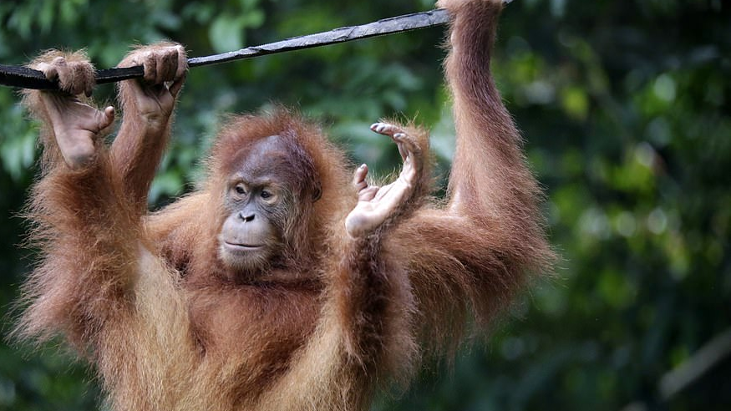
Thank you ☺
https://www.dailymail.co.uk/news/article-7154111/Orangutan-released-wild-Sumatra.html

Slide 19
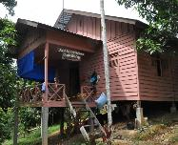
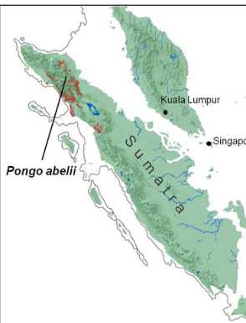
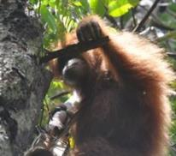
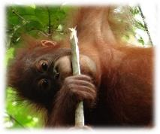












Data collection
Methods
Study site:
Behavioral measure of cognitive performance:
Exploration: “prolonged, non-repetitive, usually destructive manipulation of or feeding attempts on objects, during which the individuals focus is on the object”
Suaq Balimbing
Pongo abelii
Peat swamp forest
Study subjects:
12 immatures and their mothers, followed over multiple years
Age-individual data points:
Data of one individual
Collected within 4 months
Minimally 70 follow hours
Notes:
The data I will present were collected at the SB OU reserach site. Suaq is home to the Sumatran OU. The research area is peat swamp forest. I collected data on 12 different immatures and their mothers. And I followed them over multiple years, starting in 2101
As a behavioral measure of cognitive pervormance we took rates of exploration behavior. Exploration is prolonged, non-repetitive, usually destructive manipulation of or feeding attempts on objects, during which the individuals focus is on the object, like the guys are doing on these pics here.
One age individual data point, so all the dots you will see in the graphs that follow is always data collected on one individual, within a max of 4 months for the immatures, to capture one specific developmental state. Each data point is based on a min of 70 high quality followhours during which we collected all occurrence data of exploration events.

